Slide 1
超越学科界限的认知基础 Transdisciplinary Cognitive Foundation
Safety
Nothing
bad happens
Liveness
Some
Good Things
Must Happen
Image Source: Get your guide
Cybernetics: Control and Communication Week 08
Ben Koo
November 2, 2020

Slide 2

Logic Model
Logic Model
Output: An informal proof that demonstrates Cybernetics is about Transdisciplinary Cognitive Foundation
Process: Lecture and Discussion
Input:
Universal Computation is true
Reference material about Cyb.
Historical accounts of agencies.
Examples of tech applications
Context: Students have been introduced to NsM and Recursion
Goal: Show Cybernetics as an early attempt toward Transdisciplinary Cognitive Foundation
Criteria: introduction to
Personalities and publications
Institutions, regulatory examples
Technologies derived from Cyb.
A well-defined set of Actions and iterative Branching Strategies
A Roadmap of composable activities
Sequencing and timing conditions
Explicitly state dependencies and resource requirements
Boundary Conditions: Familiarity with HDL, PC, ALU, Memory, and Hack Assembly Language

Slide 3
Glossary
Epistemology: How knowledge is acquired (dynamic process)
Ontology: How knowledge is organized (static image of knowledge)
Cybernetics: The control and communication of systems
All ideas can be represented as Kan Extension (Categorical Structures)
These Categorical Structures can be thought of as Partially Ordered Sets(POS)
Category Theory provides a mechanism to reuse information in these POSs
Programming Techniques can compress space/time as new information arises
Think about Memoization, Tail Recursion, Iteration

Slide 4
Prior to today’s lecture
All Knowledge represented by Named Functions
This set of rules can be used recursively to generate an infinite amount of expressions.
Variable
Expression1
Expression2
𝜆
Variable
Expression
( )
Expression

Slide 5
A Rhetoric Lens to see the world
Focus on the relational structures between Names
This set of rules can be used recursively to generate an infinite amount of expressions.
Variable
Expression1
Expression2
𝜆
Variable
Expression
( )
Expression

Slide 6
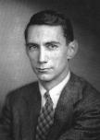
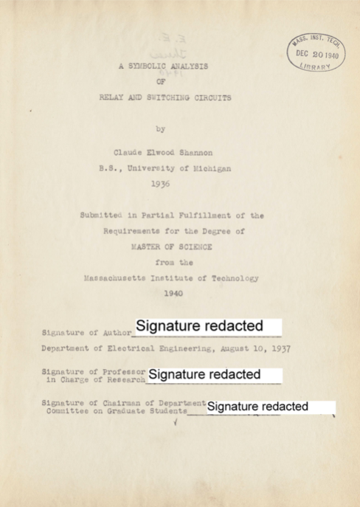
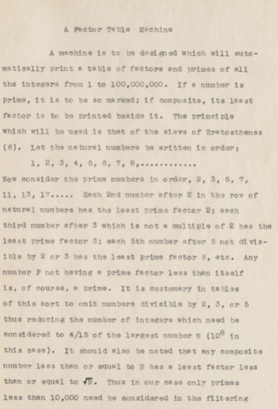
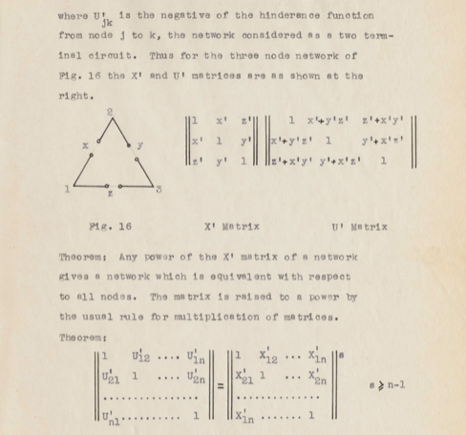
The most famous master thesis
A Symbolic Analysis
of
Relay and Switching Circuits
Claude Shannon, 1916-2001

Slide 7
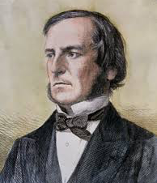
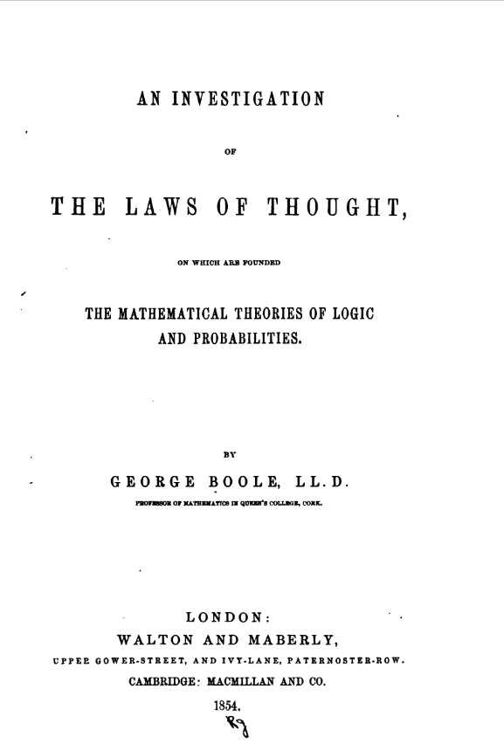
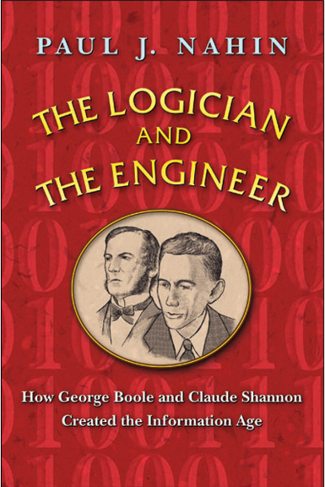
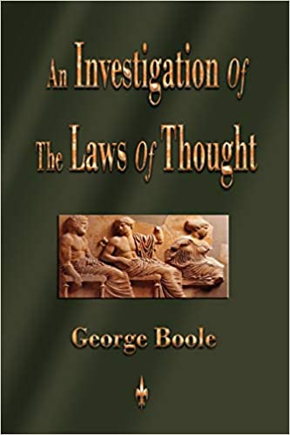
From Law of Thought to Symbolic Analysis of Circuit
George Boole
Boolean Algebra

Slide 8
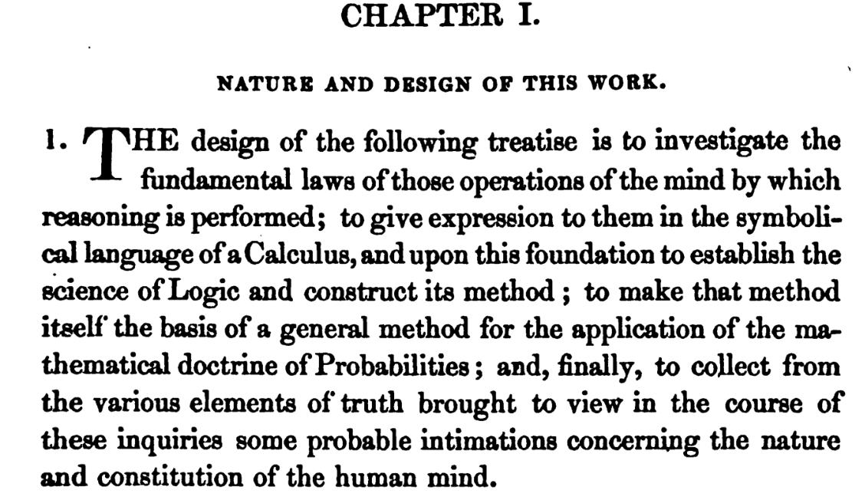
A Treatise on Cognitive Foundation
Image Source: An Investigation of the Laws of Thought by George Boole

Slide 9
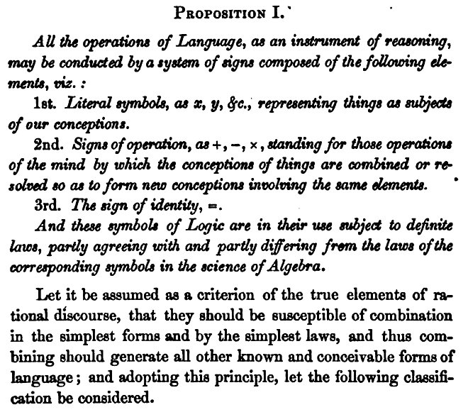
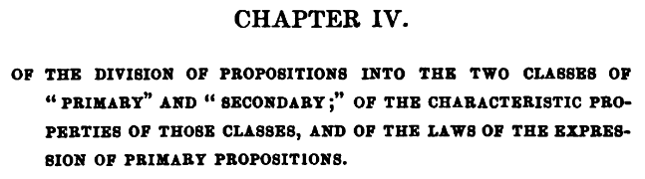
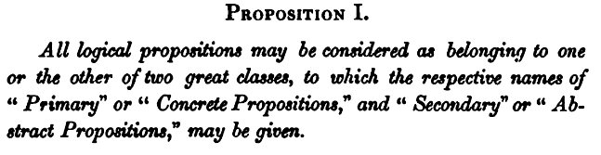
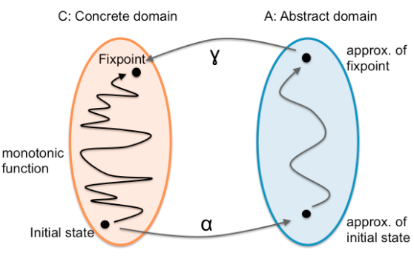
The Analysis and Classification of Signs
Image Source: An Investigation of the Laws of Thought by George Boole

Slide 10
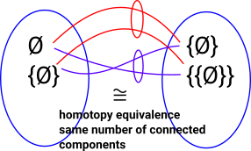
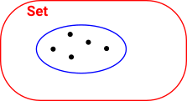
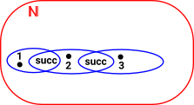
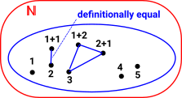
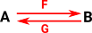
The Notion of Logical/Symbolic Equivalence
Isomorphism
Equivalence
Id_{A} = G◦F
F◦G = Id_{B}
Id_{A} ≃ G◦F
F◦G ≃ Id_{B}
Homotopy Type Theory / Univalence Axiom
Image Source: Euclidean Space on Univalence Axiom

Slide 11

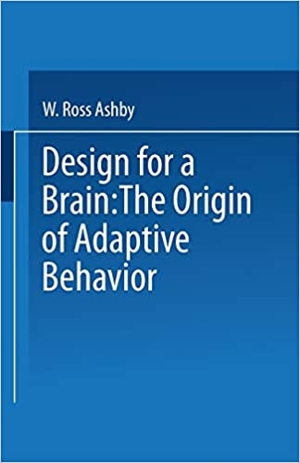
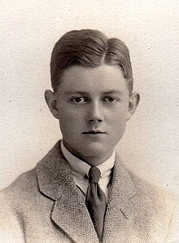
Ashby’s vision on Cybernetics
Ashby, c. 1924, aged about 21
Image Source: Introduction to Cybernetic by Ross Ashby

Slide 12
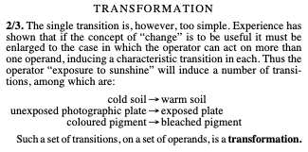
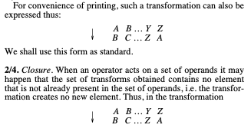
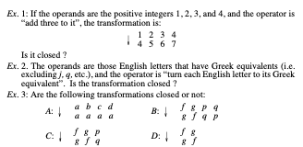
Think of Universal Mechanism as a Rewrite System
Cybernetics is similar in its relation to the actual machine. It takes as its subject-matter the domain of “all possible machines”, and is only secondarily interested if informed that some of them have not yet been made, either by Man or by Nature. What cybernetics offers is the framework on which all individual machines may be ordered, related and understood.
Text and Image Source: Introduction to Cybernetic by Ross Ashby

Slide 13
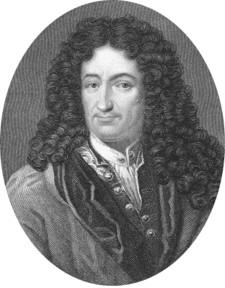
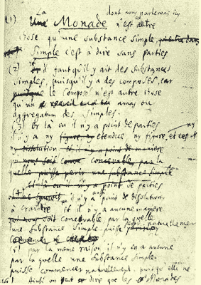

Monad and Leibniz
The Monad, of which we shall here speak, is nothing but a simple substance, which enters into compounds. By ‘simple’ is meant ‘without parts’. (Theod. 10.)
And there must be simple substances, since there are compounds; for a compound is nothing but a collection or aggregatum of simple things.
Now where there are no parts, there can be neither extension nor form [figure] nor divisibility. These Monads are the real atoms of nature and, in a word, the elements of things.
…. From home.datacomm.ch/kerguelen/monadology/monadology.html

Slide 14
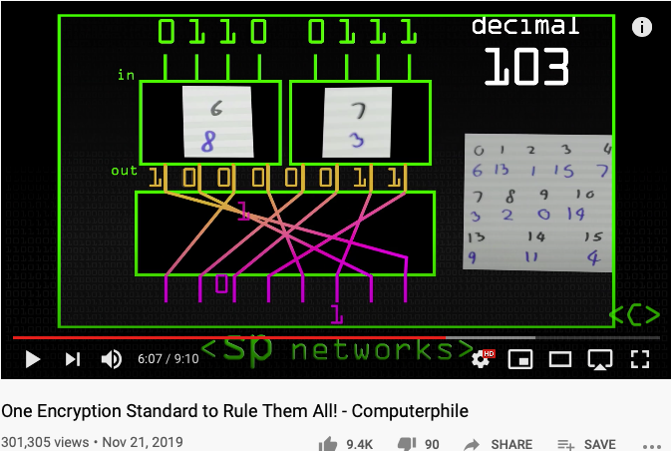
One Encryption Standard to Rule them All
AES replaced IBM’s DES standard because:
A longer (more secure) key length
Faster encryption

Slide 15
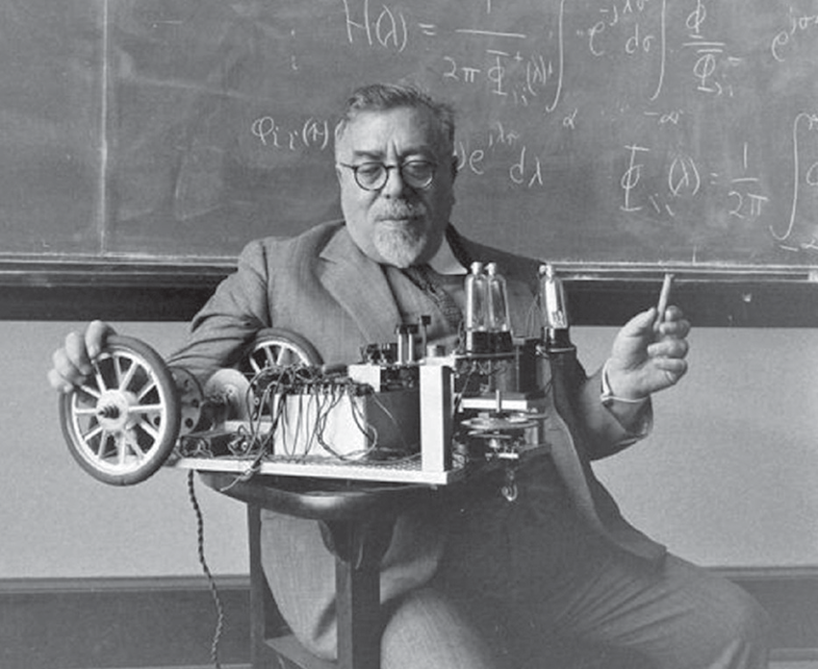
The Dominant Personality behind Cybernetics
Cybernetics:
the science of control and communication in the animal and the machine.
- Norbert Wiener
Image source: Research Gate download Link
Innovation occurs at the boundary of disciplines by competent people.
- Norbert Wiener

Slide 16
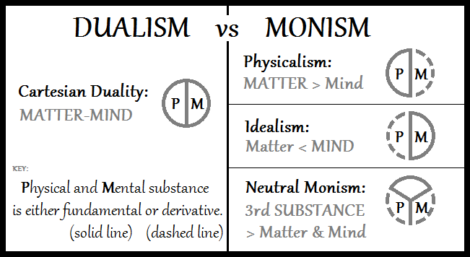
From Monism, Dualism to Cyber-physical Systems
Image Source: Double-aspect Theory on Wikipedia

Slide 17
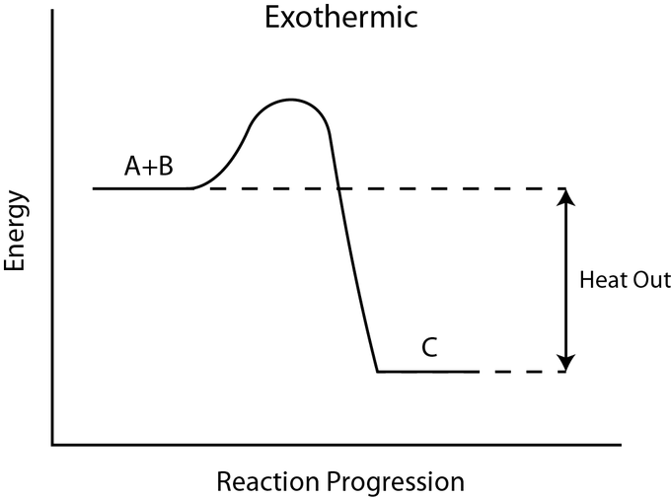
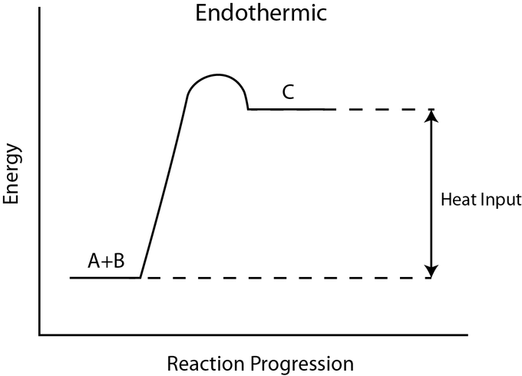
Exothermic and Endothermic
Image Source: exo and endothermic processes on Lumen Learning

Slide 18
Market Dynamics
Bearish Market
Bullish Market
Transaction Costs
Transaction Costs
Image Source: exo and endothermic processes on Lumen Learning

Slide 19
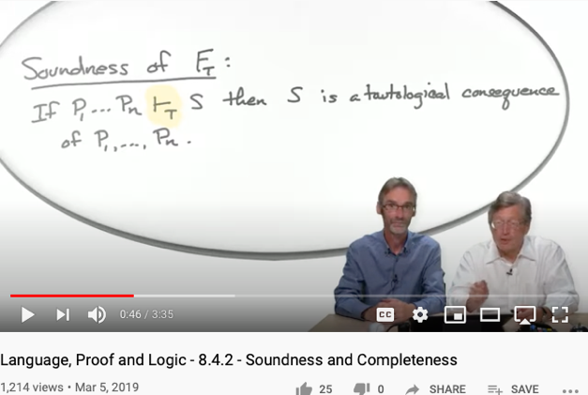
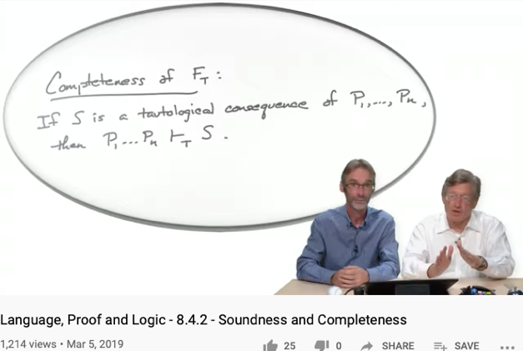
Soundness
Completeness
For engineering/scientific purpose, it is difficult to escape Monism
The unifying notion of “Truth” is the source of Monism
Every provable statement is true
Every true statement is provable
Cited from : Soundness and Completeness: With Precision on news.ycombinator.com
https://youtu.be/3hspKYIn5ds?t=29
https://youtu.be/3hspKYIn5ds?t=162

Slide 20
What is the big deal?
New instrumentation is giving Cybernetics to interact with human at different scales:
Many complex ethical concerns becomes everyday decisions
Consensus must be reached a higher frequencies than before
Choice of vocabulary is affecting the efficiency of search
User Interface Design and the nature of “Scalable Consensus”
Time and Space has been compressed to form new identities
Automated Verification Tools must be applied before any social commitment

Slide 21
Recognizing the Fact
All Knowledge represented by Named Functions
This set of rules can be used recursively to generate an infinite amount of expressions.
Variable
Expression1
Expression2
𝜆
Variable
Expression
( )
Expression

Slide 22
The Universal Structure in 𝜆-Calculus Form
Expression := Contextualized Data (* Known interpretation results, no computation *)
| Goal_Exp Criteria_Exp (* Timeless and Time-based expressions *)
| 𝜆 Input Output_Exp(Input) (* A Computing Process *)
| ( Exception_Handling ) (* Stated boundary conditions/Exceptions *)
This set of rules can be used recursively to generate an infinite amount of expressions.
What
Contextualized data
Goal Expr
Criteria Expr
Why
𝜆
Input
Output Spec
How
( )
Exception Handling

Slide 23
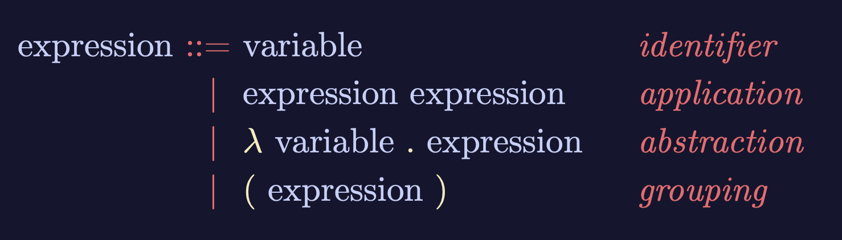
Recursive Structures as a Rewrite System
(Rewrite = Replacement)
Image Source: https://speakerdeck.com/glebec/lambda-calc-talk-frontside-version?slide=66

Slide 24
Monad is an actionable Abstraction
Image Source: https://speakerdeck.com/glebec/lambda-calc-talk-frontside-version?slide=66

Slide 25
Universal set of Replacement Rules
Expression := Variable (* Atomic results, replace nothing *)
| Expression Expression (* Expansive or One-to-Many replacement *)
| 𝜆 Variable Expression (* replace variable content in Expression *)
| ( Expression ) (* Isolate replaceable Expression with boundaries *)
This set of rules can be used recursively to generate an infinite amount of expressions.
Variable
Expression1
Expression2
𝜆
Variable
Expression
( )
Expression

Slide 26
This might look familiar
Expression := Contextualized Data (* Known interpretation results, no computation *)
| Head_Exp Tail_Exp (* Timeless and Time-based expressions *)
| 𝜆 Input Output_Exp(Input) (* A Computing Process *)
| ( Bounded_Exp ) (* Stated boundary conditions/Exceptions *)
This set of rules can be used recursively to generate an infinite amount of expressions.
Contextualized data
Head
Tail
𝜆
Input
Output Spec
( )
Bounded Expression

Slide 27
This meaning of “Equal”
Expression := Contextualized Data (* In a rewrite system, equal or := is a rewrite rule *)
| Head_Exp Tail_Exp (* this is a branching structure *)
| 𝜆 Input Output_Exp(Input) (* A simplification procedure*)
| ( Bounded_Exp ) (* Special case manipulation/Exceptions *)
For single threaded computation, all functions can be derived from here.
For multiple-threaded system, see 𝞹-calculus
Contextualized data
Head
Tail
𝜆
Input
Output Spec
( )
Bounded Expression

Slide 28
Controlling Types
A unique feature of Category Theory, is that it provides a meta-mathematical framework to introspect itself. This can be found in the way lambda calculus and the three types of functions, namely
Morphisms (Head label representing its tail or content)
Functors (An indirection that allows some intermediate replacement action)
Natural Transformations, (A kind of function that points to itself)
are defined. This mathematical framework uses only three types of functions (functions being the root type), to represent everything.
This flattened type examination mechanism, instill a universal discipline to check and verify soundness and completeness of all variations of structures, as well as values in any namespace, so that it provides the most succinct, yet overarching abstraction of all.
More importantly, this universal mechanism has been operationalized by computing machinery to offer both automation as well as scalable reasoning of type, so that it is becoming a foundational layer of our modern civilization. The incorrect or biased implementation of this mechanism, is the source of inequality in our society.

Slide 29
Relevance to Cybernetics
The control and communication of systems requires not just raw content, but a structure to manage the interpretation of implicit relationship between entities in a system. This has been a major hurdle that hasn’t be addressed in most other types of mathematical framework, until Category Theory.
Now, the type-based interpretation framework can be found in many fields of mathematics, partially due to the revelation in Logic, Lambda Calculus, and Category Theory. That all these implicit structures are isomorphically mapped to each other, also known as the “Curr—Howard-Lambeck Correspondence”.
It is because of this correspondence, and the universality of this correspondence, that makes people start thinking that all sciences and mathematical principles can only be discovered, not invented, because they must have already been there before one’s invention.
This is relevant to cybernetics, because in the field of control and communication, many ideas and techniques must have already been found and developed in math, and computing science, therefore, the techniques and knowledge in Cybernetics, must be re-discovering rules and properties that is already in Category Theory and other topological structures in nature.

Slide 30
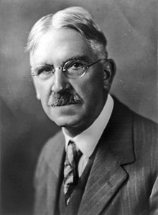
A philosophical way to interpret Self-Reference
“The self is not something ready-made, but something in continuous formation through choice of action.”
- John Dewey
On page 408 of the Philosophy of Education

Slide 31
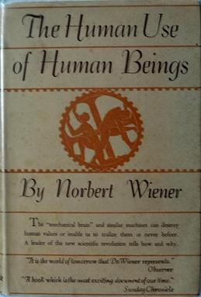
Cybernetics: The human use of human beings
The thesis of the book is that:
society can only be understood through a study of the messages and the communication facilities which belong to it; and that in the future development of these messages and communication facilities, messages between man and machines, between machines and man, and between machine and machine, are destined to play an ever-increasing part. (p. 16)
- Wikipedia on Human use of Human Beings
“Some agents can transcend one system and reset its goals from a vantage-point of a meta-system (Hofstadter, 1979). While many animals are capable of a wide repertoire of diverse goal-seeking activity, human minds appear to be (for now) in a unique position. .”
- Michael Levin in the computational boundary of “self”

Slide 32
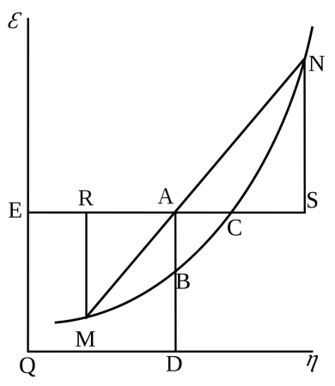
Cybernetics: Entropy and Negative Entropy
Wiener believed that communication of information is essentially negentropic – it resists entropy –, because it relies on organizational structures. There are two kinds of possible disorganizational forces, passive and active:
"Nature offers resistance to decoding, but it does not show ingenuity in finding new and undecipherable methods for jamming our communication with the outer world" (pp. 35–36).
- Wikipedia on Human use of Human Beings
Willard Gibbs’ 1873 available energy (free energy) graph, which shows a plane perpendicular to the axis of v (volume) and passing through point A, which represents the initial state of the body. MN is the section of the surface of dissipated energy. Qε and Qη are sections of the planes η = 0 and ε = 0, and therefore parallel to the axes of ε (internal energy) and η (entropy) respectively. AD and AE are the energy and entropy of the body in its initial state, AB and AC its available energy (Gibbs energy) and its capacity for entropy (the amount by which the entropy of the body can be increased without changing the energy of the body or increasing its volume) respectively.
- Wikipedia on Negentropy

Slide 33
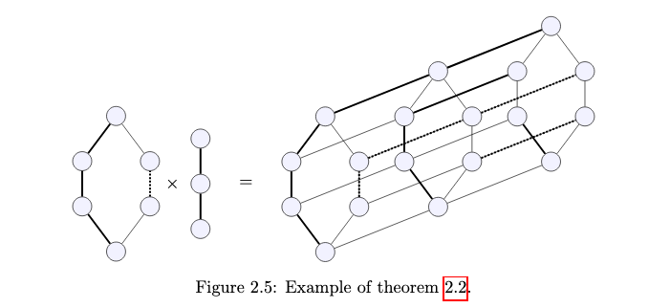
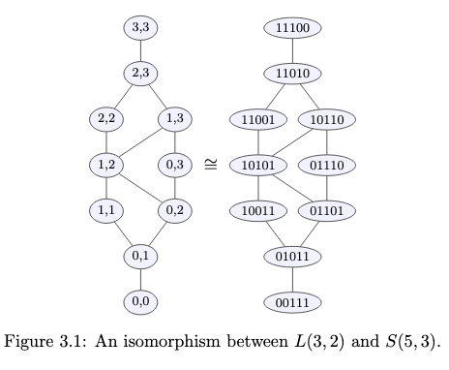
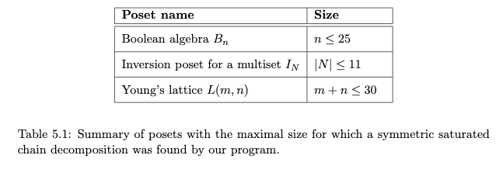
Entropic namespaces in Partially Ordered Sets
Image Source: Symmetric chain decompositions of partially ordered sets by Ondrej Zjevik

Slide 34
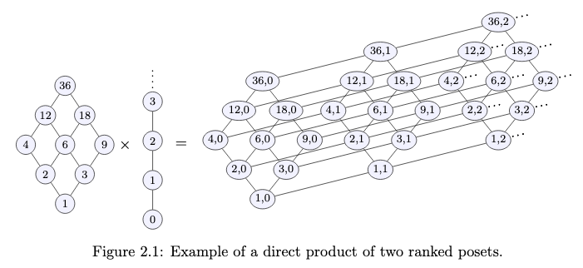
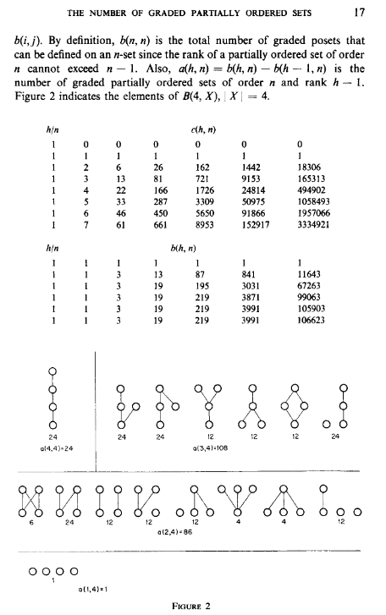
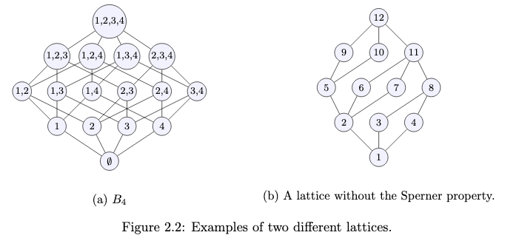
Poset as Composable Namespaces
Image Source: Symmetric chain decompositions of partially ordered sets by Ondrej Zjevik
Image Source: The Number of Ordered Partially Ordered Sets by David Klarner

Slide 35
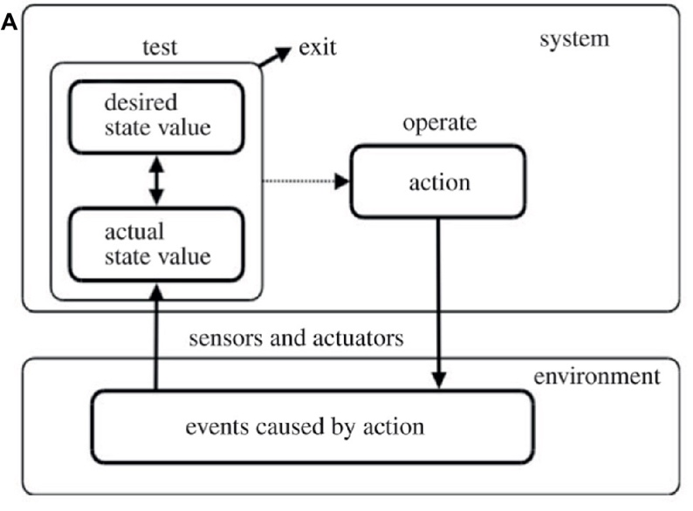
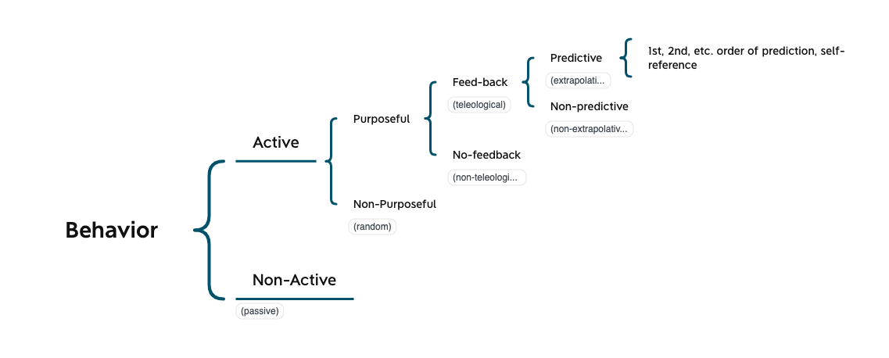
Scales of Control in Cybernetics
Figure 1 of The Computational Boundary of a “Self”

Slide 36
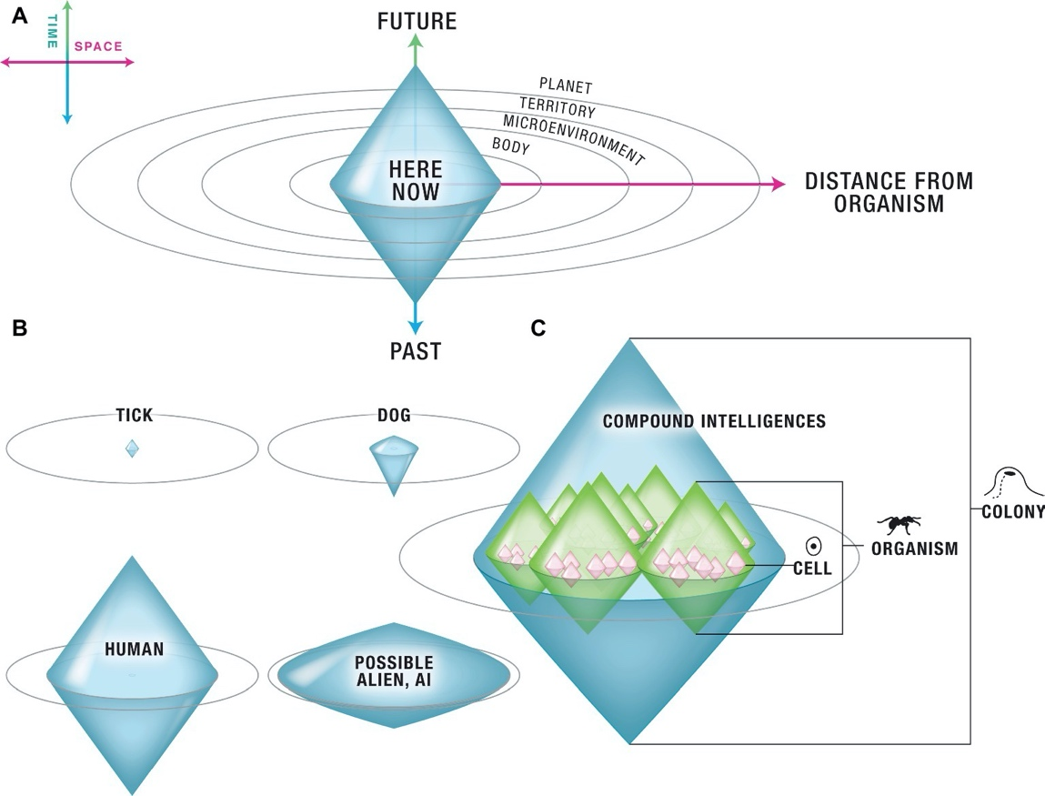
Controlled Boundaries (Poset) of different Scales
Figure 2 of The Computational Boundary of a “Self”

Slide 37
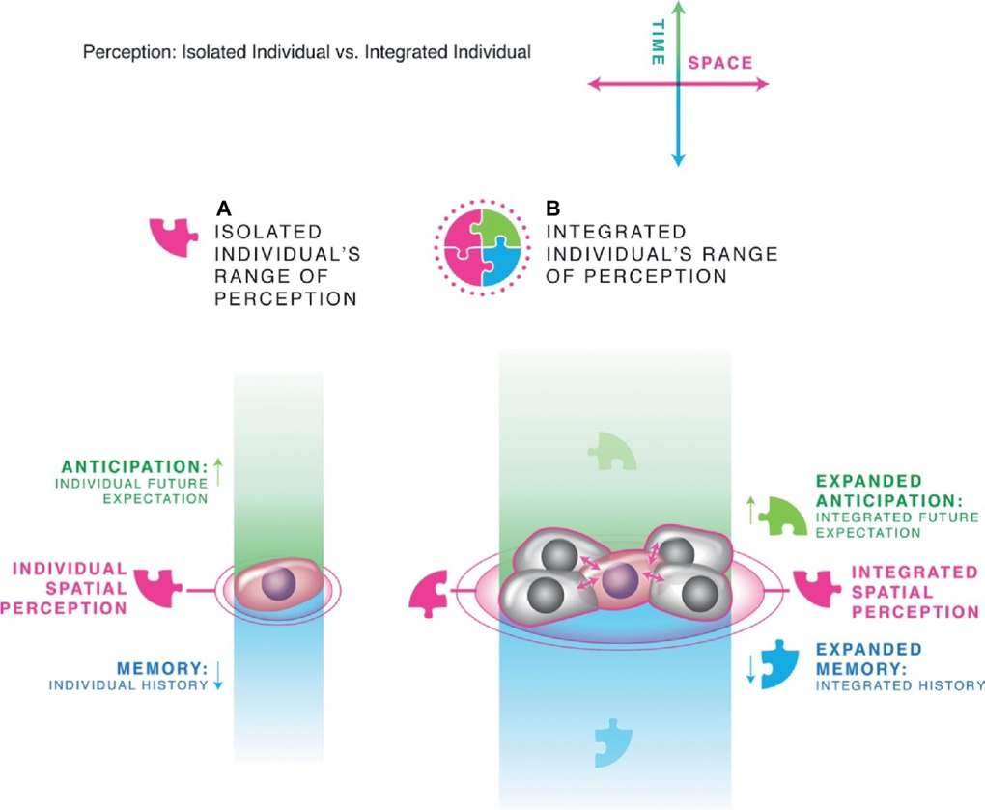
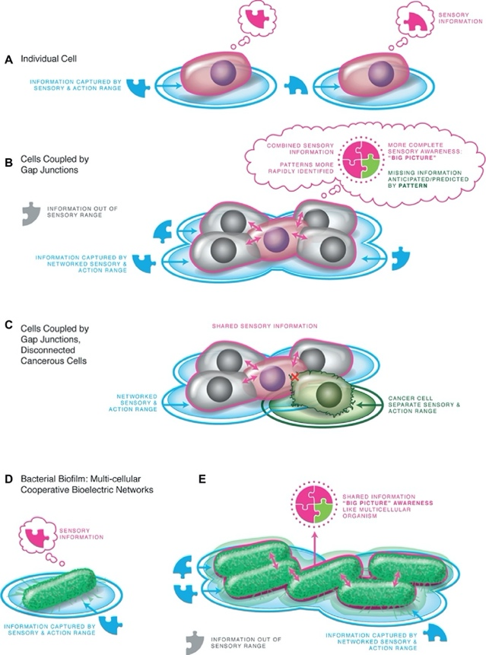
Controlled Boundaries of different Scales
Figure 3 and 4 of The Computational Boundary of a “Self”

Slide 38
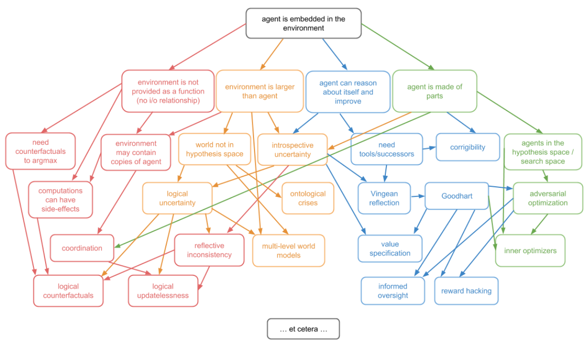
Agent actions in the world of Posets
On P.4 of Embedded Agency by Abram Demski, Scott Garrabrant

Slide 39
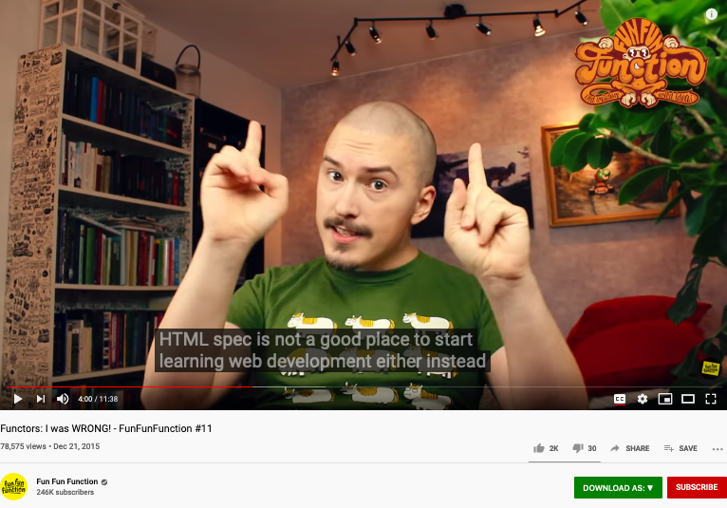
A cool video on Functors
https://youtu.be/DisD9ftUyCk?t=240

Slide 40
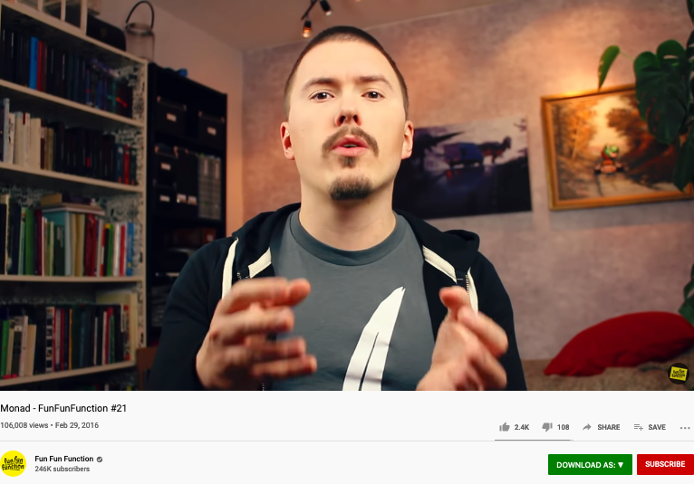
A cool video on Monad
https://youtu.be/9QveBbn7t_c

Slide 41


Hamiltonian Mechanics make energy Accountable
Assets = Liability + Equity
and
H = T + V
These two equations basically dominated two fields: Economics and Physical Sciences
Thinking from a Meta-Mathematical viewpoint,
they present a way to break down the total amount of conservative resources,
and therefore, allows iterative branching and therefore continuous replication.
Notes:
“historian James Aho linked double-entry bookkeeping to the ancient art of rhetoric,”
Excerpt From: Jane Gleeson-White. “Double Entry.” Apple Books.

Slide 42



Hamilton did more work on the Accounting Equation
The aim of this paper is to show how the mathematical basis is used for a precise treatment of double-entry bookkeeping, which was firstly developed in the nineteenth century by Sir William Rowan Hamilton. This is done by using basic notions of matrix algebra with the roots to the idea of using ordered pairs. We also reveal how the complex numbers and the rationals (fractions) developed in a mainstream of accounting science and became a leading platform for the ongoing processes within the Industry 4.0.
Image Source: Research Gate
Notes:
In the presentation on Oct-9, 2020, Ray again, stated a link between the Atomic Explosion’s 20 thousands generations of chain reactions and the layers of Syntatic Trees in Chomsky’s Syntactic Theory about language. Then, he also reminded us that Chomsky and Shannon were working in locations that are 100 feet away from each other. The white and black dots are demonstrating the patterns of Fibonacci series.

Slide 43



Kuhn Cycle: recursion and symmetry-breaking
Keeping namespace consistent (is challenging)
Normal Science
Model
Drift
Model Crisis
Model Revolution
Paradigm
Change
Emerging cases or
systematic attacks
Ouroboros Snake
in five named stages

Slide 44
The second Language Design Strategy
combine structure with operations!
The isomorphism between accounting equation and the Hamiltonian formulation states: Science is about utilizing symmetries/invariance recursively.
Put the Accounting /Hamiltonian equation in a matrix structure, the addition operations becomes iterative.

Slide 45

Concrete Activities in Daily Workflow
What is DevSecOps?
Image courtesy: Paladion Corporation Website Image source: https://www.paladion.net

Slide 46

A short introduction video
https://youtu.be/j2m5YMnHvQQ

Slide 47





Connecting Abstract and Concrete Domains
4th POPL, pages 238-252, Los Angeles, CA, 1977. ACM Press.
Prof. Cousot and Koo in 2005
Course number: 16.399 Title: Abstract Interpretation Units: H level course, 3-0-9 Lecture hours: Tuesday 11:00–12:30 and Thursday 11:00–12:30 (see the course schedule for exceptions) Location: 33–419 Course web site: http://web.mit.edu/afs/athena.mit.edu/course/16/16.399/www Prerequisites: basic skill in mathematics and experience with computer programming.
Conclusion (the second paragraph)
There is a fundamental unity between all these apparently unrelated program analysis techniques : a new interpretation is given to the program text which allows to build an often implicit system of equations. The problem is either to verify that a solution provided by the user is correct, or to discover or approximate such as solution.
http://web.mit.edu/afs/athena.mit.edu/course/16/16.399/www/

Slide 48
Abstraction
Concretization
Why is abstraction useful?
Allow reuse through universal properties
Avoid resource conflicts
Scale free and domain neutral
Generalizing concrete experience?
Make analogies in localized contexts
Engage sensible metaphors
Define terms and boundaries
A well-defined set of Actions and iterative Branching Strategies
A Roadmap of composable activities
Sequencing and timing conditions
Explicitly state dependencies and resource requirements

Slide 49


打破认知边界的传奇符咒
系统的两类合约：
安全与活性
Safety: （安全）
Something bad never happens
Liveness: （活性）
Something good eventually happen
The Byzantine Generals Problem * 388
找到了计算信息传递可信度的数学理论
拜占庭将军的问题：提出了分布式数据库的可信度检验算法
http://slideplayer.com/slide/4339032/
ACM Transactions on Programming Languages and Systems, Vol. 4, No. 3, July 1982.

Slide 50

Abstraction
Concretization
Why state objectives on paper?
Accentuate objectives in prescribed contexts
Define roles not persons
Objective law enforcement
Why specify key results?
Make explicit targets to orient actions
Assign responsibilities to persons
Fairness in Rewards/Punishment
A well-defined set of Actions and iterative Branching Strategies
A Roadmap of composable activities
Sequencing and timing conditions
Explicitly state dependencies and resource requirements
Namespace (Data Asset) Management

Slide 51
Think about all activities as Posets software projects in version control database
Normal Science
(commit)
Model
Drift
(build)
Model Crisis
(test)
Model Revolution
(stage)
Paradigm Change
(deploy)
Time Stamp
Time Stamp
Time Stamp
Time Stamp

Slide 52

Paxos as a Poset

Slide 53

Why is Simplicity in NsM so Strategic
Controlled Entropy = Controlled Time
Think about Google’s interface
Why are they removing buttons on iPhone?
Bound Variables in Logics
When complexity is inevitable
Leverage the notion of symmetry
See Hermann Weyl’s quote on lacking information…
Image Source: Intro to System Science and Cybernetics,
Dr Paul Pangaro

Slide 54


The Meaning of being True
Russel once said: “Mathematicians’ job is about classifiying.”
Mathematics is the art of giving the same name to different things.^{[10]} Henri Poincaré

Slide 55

How to Think Mathematically?
Mathematics is the art of giving the same name to different things.^{[10]} Henri Poincaré

Slide 56





Holacracy: a mechanism for Communication and Control
Holacracy applied Recursively
Image Source: Holacracy: The New Management System for a Rapidly Changing World

Slide 57
Abstraction
Concretization
Safety
Nothing
bad happens
Liveness
Some
Good Things
Must Happen
A well-defined set of Actions and iterative Branching Strategies
A Roadmap of composable activities
Sequencing and timing conditions
Explicitly state dependencies and resource requirements
Correctness

Slide 58
Iteratively Fixing Security Problems
Technology Integration
Technology
Society
Security
Technology
Security
Society
Technology Isolation
Modified from Figure 1-1 and 1-2 of Agile Application Security: Enabling Security in a Continuous Deliver Pipeline,
by Laura Bell, Michael Brunton-Spall, Rich Smith & Jim Bird, O’Reilly Media, 2017

Slide 59



The Version Control, Built, Test, Stage, Deploy are Conducted by Human Instructions
Think of a multi-staged snake…
Image courtesy: Learn How to Set Up a CI/CD Pipeline From Scratch on DevOps Zone

Slide 60
A compositional view of system correctness
Liveness
Safety
Correctness
The Theoretical Definition of System Correctness
Correctness = Liveness ∧ Safety
Liveness: Something good eventually happens
Safety: Nothing bad ever happens

Slide 61

The Commit-Built-Test-Stage-Deploy are Fully Automated
Image courtesy: Learn How to Set Up a CI/CD Pipeline From Scratch from DevOps Zone

Slide 62
Continuously Adjust the Correctness Area
Liveness
Safety
Correctness
The Inremental Change Approach promoted by DevOps/CICD practitioners

Slide 63


The CAP Theorem in NsM
RICH 70 Tsinghua SEA Cloud Forum, Sep 14, 2020
H. E. Bambang Brodjonegoro,
Minister of Research & Technology, Indonesia

Slide 64
Abstraction
Concretization
Choose a namespace (language)
Given resource bounds, satisfy functional soundness and completeness
Specify what is safe
Specify what is alive
Create the namespace (language)
Use TLA+ and K-framework to ensure satisfaction
Reason about safety via static analysis
Assess liveness via dynamic analysis (execute test runs)
A well-defined set of Actions and iterative Branching Strategies
A Roadmap of composable activities
Sequencing and timing conditions
Explicitly state dependencies and resource requirements

Slide 65

Abstract Specification
Concrete Implementation
A well-defined set of Actions and iterative Branching Strategies
A Roadmap of composable activities
Sequencing and timing conditions
Explicitly state dependencies and resource requirements
Namespace Management

Slide 66


Cybernetics at a Scale of Internet Economy

Slide 67

The Service Value Chain of the Networked Economy

Slide 68

SLA, OLA, and UC
Acronyms
SLA: Service Level Agreement
OLA: Operational Level Agreement
UC: Underpinning Contracts
ITIL (IT Infrastructure Library)
Namespace management for IT services
A new industry standards body

Slide 69


Abstract Specification Format IT Service Management through SLA

Slide 70


Concrete Implementation ITIL: Accounting System for Safety and Liveness
RICH 70 Tsinghua SEA Cloud Forum, Sep 14, 2020
H. E. Bambang Brodjonegoro,
Minister of Research & Technology, Indonesia
p.33 of ITIL for Dummies
By Peter Fareden
p.97 of Effective IT Service Management to ITIL and Beyond
By Rob Addy

Slide 71

ITIL’s Service Classification
Image Source: ITIL for Dummies P.74
The Cabinet Office refers to UK’s Cabinet.

Slide 72

Types of Digital Assets
Asset Container | Operations | Tools
File(Document) | Content Editing | MediaWiki
File Directories | Changing File Structures | Git
Micro Services | Execute Programs | Docker
Configuration Data | Deployment & Maintenance | Kubernetes
Physical Environment | Physical Actions | Hackerspaces

Slide 73

Digital Tools in Software Containers

Slide 74














Computing Architectures associated with Tools
Abstract Specification
Cloud Computing
Deterministic
Probabilistic
Centralized
Hybrid
Distributed
Single/Multi Core
Many Core
Single Site
Multi Site
Many Site
Hackerspaces
Super Computing Center
Notes:
74

Slide 75

Why is this a big deal?
With data content becomes
Trust-worthy, Provably correct (TLA+)
Privately searchable (Elastic Search)
Tailored for personal use
A publicly admitted pricing system
Account Management
Privacy Protection

Slide 76





You are in the Universal Namespace, now!
Library of
Linked Knowledge
(Data Plane)
Library of Executable Algorithms
(Control Plane)

Slide 77








How to organize a unifying Trust-worthy Namespace?
Ground in arithmetic rules (Gödel Numbering)
Organize knowledge in terms of Meta-Mathematics
Store content in Distributed Hyperlinked Databases

Slide 78

In DevOps/CICD Jenkins holds the key!
Jenkins enables all system-level actions to be triggered with properly assigned names.

Slide 79

Jenkins actions are managed in the Namespaces of Plug-ins

Slide 80
Summary
Writing (Data recording) enables accountability
Create collective consciousness across spacetime
NsM reasoning through Abstract Interpretation and K-Framework
Temporal Reasoning using TLA+,
Written records became valuable through Namespace Management (NsM)
Generic Consensus Algorithms enable distributed processes to effectively accountable
NsM is achieved through Proposal -> Learning -> Syncing -> Expiring cycles
Use a unifying Abstraction to separate Structures from Processes
Concrete Data values are captured using scalable IT infrastructures
Generic writing and accounting system as Knowledge Management Standards (ITIL)

Slide 81
Your actions before Oct 19, 2020
Start using Templates and Categories on toyhouse.wiki:81
Create a page about your project, using standardized Templates and Category
Make sure all Wiki pages you created follow the same Namespace convention
Start using Github to download and share files with proper NsM
Couse Github @ https://github.com/benkoo/CognitiveFoundation2020
Start writing your learning report.
Every week should include Logic Model using the standard Template
500 words or more per week

Slide 82


A Pioneering book in Transdisciplinary Studies

Slide 83

Table of Content

